Slide 1
INTERNETWORKING TECHNOLOGY PROJECT
IEEE 802.15.4 TSCH
TUSHAR CHATTOPADHYAY-2020A7PS0158H
SAMYAK GOEL-2020B2A72442H

Slide 2
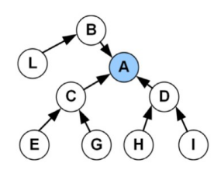
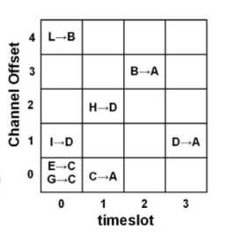

Slide 3
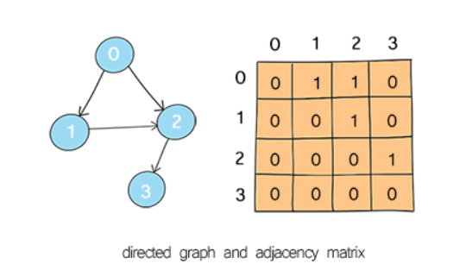
Adjacency matrix of the said graph
Points to achieve during this process:
Maximum path length from our target node.
Finding the nodes which have in-degree equal to 0. (A node has degree 1 when the sum of all the elements in the particular column of that node is equal to 0)

Slide 4
3) We store the communication links as pairs in a vector data structure.
4) We divide the graph into sets of communication links. The first set containing all the nodes with 0 in-degree and their adjacent nodes, the second set containing the nodes adjacent to 0 in-degree nodes and other adjacent nodes excluding 0 in-degree nodes and so on.

Slide 5
Making the timetable
The number of timeslots in a cycle in the timetable will be equal to the maximum path length from our target node.
The number of offsets in the timetable will be equal to the number of nodes which are receiving data from all the 0-indegree nodes.

Slide 6
Generating a random number
To make a random timetable for all the nodes to pass on data, we generate a random number using current time as a seed so that the seed for each iteration is different .
We fill the vector containing pairs in the 2d matrix by dividing the random number by the number of rows and keeping a track if the allotted row is filled or not.
If two communication links in the same timeslot have the same destination, then they use the same communication channel.

Slide 7
Scope for improvement:
We can try to make the process more random
We can try to optimise the time and space complexities.

Slide 8
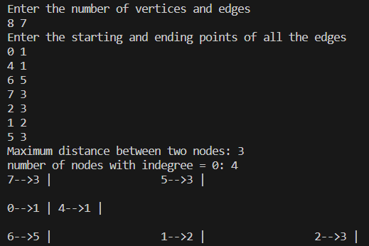
Sample snippet of input and output

Slide 9
Thank you

